Slide 1
Luke 2:41-52
(English Standard Version)

Slide 2
⁴¹ Now his parents went to Jerusalem every year at the Feast of the Passover. ⁴² And when he was twelve years old, they went up according to custom. ⁴³ And when the feast was ended, as they were returning, the boy Jesus stayed behind in Jerusalem. His parents did not know it, ⁴⁴ but supposing him to be in the group they went a day’s journey, but then they began to search for him among their relatives and acquaintances, ⁴⁵ and when they did not find him, they returned to Jerusalem, searching for him. ⁴⁶ After three days they found him in the temple, sitting among the teachers, listening to them and asking them questions. ⁴⁷ And all who heard him were amazed at his understanding and his answers.

Slide 3
⁴⁸ And when his parents saw him, they were astonished. And his mother said to him, “Son, why have you treated us so? Behold, your father and I have been searching for you in great distress.” ⁴⁹ And he said to them, “Why were you looking for me? Did you not know that I must be in my Father’s house?” ⁵⁰ And they did not understand the saying that he spoke to them. ⁵¹ And he went down with them and came to Nazareth and was submissive to them. And his mother treasured up all these things in her heart.
⁵² And Jesus increased in wisdom and in stature and in favour with God and man.

Slide 4
Proverbs 22:(ESV) ⁶ Train up a child in the way he should go;
even when he is old he will not depart from it.
A big responsibility – to raise a child in the way of the Lord
Sometimes difficult (when they are grown) to relinquish control
and let them be the young men and women we have trained them to be.
Little boy lost???? or Youth on cusp of becoming a man somewhere unexpected...

Slide 5
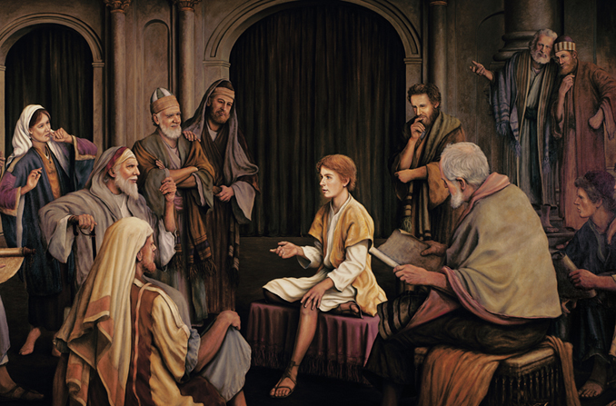

Slide 6
Proverbs 22:(ESV) ⁶ Train up a child in the way he should go;
even when he is old he will not depart from it.
A big responsibility – to raise a child in the way of the Lord
Sometimes difficult (when they are grown) to relinquish control
and let them be the young men and women we have trained them to be.
Little boy lost???? or Youth on cusp of becoming a man somewhere unexpected...
Jesus’ unique attachment to the Father
Learning in the temple.
Asking astute questions; Giving answers that demonstrate insight.
Did you not know that I must be in the ____ of my Father? (things of my Father)
A Balanced growth:
Wisdom – knowing the Godly thing to do in every situation.
Physical growth – Food, health, fitness etc.
Social development – being able to relate to others and socialise in a godly way
Spiritual development – Pray; Read God’s Word; Worship; Fellowship
Jesus’ Father in Heaven is Our Father in Heaven
Why would you not expect me to be here –– in the things of my Father

